Slide 1
MIPS Open Developer Day
Saraj Mudigonda
Yuri Panchul
Daniel Bowman
Siobhan Lyons

Slide 2
Agenda
12:30 - 1:15pm Welcome & Introduction
1:15 - 1:45pm Demo: MIPS Components in Action
1:45 - 2:00pm Break
2:00 - 3:30pm Hands-on Labs & Exercises
3:30 - 3:45pm Break
3:45 - 4:45pm Build Your Own MIPS-based SoC
4:45 - 5:15pm Present Your innovation
5:15 - 5:30pm Wrap-up
Wave Computing © 2019
2

Slide 3
Housekeeping
Workshop Prerequisites
Sign up and activate a MIPS Open account - CLICK HERE
Accept the License Agreement and request the MIPS Open FPGA package in the downloads section - CLICK HERE
A Windows or Linux notebook
Loaner Hardware
Altera/Xilinx FPGA Boards
USB Hub
Cables
SSD Drive
What is included in SSD Drive?
MIPS Open FPGA – Developer Day package
Altera Quartus and Xilinx Vivado tools
Housekeeping
Please delete the Altera Quartus and Xilinx Vivado tools on the SSD!!!
When you leave the class, please leave the FPGA boards, cables and USB hub.
The SSD is yours to take home
3

Slide 4
Welcome & Introduction
4

Slide 5

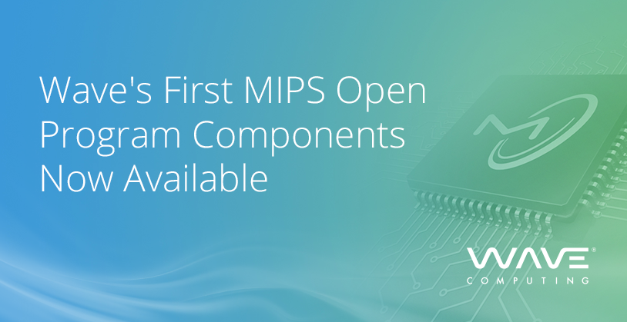



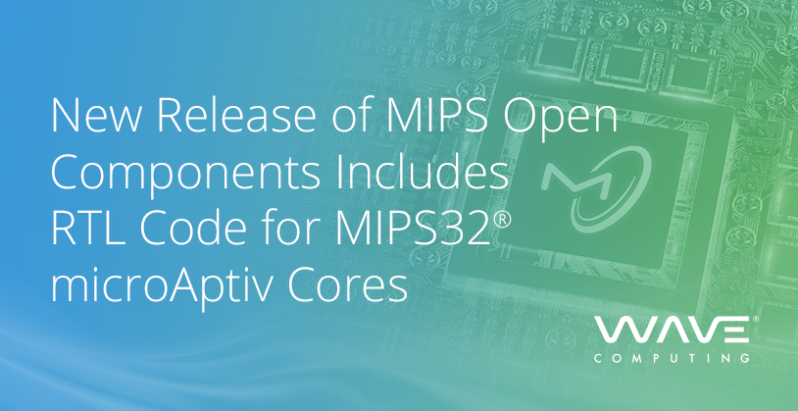
MIPS Open Milestones
Wave Computing and Imperas Introduce New MIPS Open Simulator—MIPSOpenOVPsim™
Feb 19th, 2019
May 13th, 2019
Dec 17th, 2018
March 28th, 2019
May 30th, 2019
Notes:
Wave announced the intent to open the MIPS Release 6 architecture in Dec’18
Established as a Member Committee within the prpl Foundation, an open source, collaborative non-profit organization in Feb’19
First MIPS Open components that includes R6 architecture, tools, FPGA package in March’19
Released microAptiv RTL package earlier today
5

Slide 6




MIPS Open Components
MIPS Open Tools
Integrated Development Environment
Includes both Embedded RTOS & Linux editions
Extensible framework for 3rd party tools
Non-production implementation for teaching, training, evaluation
25 hands-on labs
Preconfigured basic microAptiv core
MIPS Open FPGA
MIPS Open Cores
Verilog Source RTL Package
Includes microAptiv Microprocessor & Microcontroller cores
Ideal for battery-powered applications
Latest Release 6 Architecture that includes both 32-/64-bit ISA and extensions – DSP, SIMD, VZ, MT for multimedia, automotive, IoT, modem applications
MIPS Open Architecture
Notes:
MIPS Open Components consists of comprehensive package that includes
latest 32bit/64bit architecture, DSP, SIMD, MT, VZ extensions
Verilog RTL code for microAptiv cores
FPGA package includes fixed configuration of microAptiv core for teaching, training and evaluation purposes
Suite of tools and software include QEMU simulator and other 3rd party tools
6

Slide 7
MIPS Open Features
Open Use License
No license fees, no royalties, non-exclusive, worldwide license
Latest MIPS R6 architecture, microAptiv cores, Tools
Right and license under R6 architecture patents to design, build and sell cores
Use of the “MIPS Certified” trademark logo for certified cores
Certification
Patent License
Comprehensive Package
Notes:
Some of the key features of MIPS Open are – no license fee or royalties, latest architecture, Patent rights and license and certification services for compliance with MIPS architecture
7

Slide 8

MIPS Open Benefits
Unified Approach
Proven Architecture
Established Ecosystem
Matured Technology
Notes:
Unified Approach: Compatibility, No Fragmentation, Same tools, software, Flexibility – UDI (User-Defined Instructions) support
Proven Architecture: MIPS architecture-based designs are shipping in billions of devices, Shipping Products – wired modems, wireless modems – LTE/5G/Wi-Fi, IoT, automotive – ADAS, data centers, AI and others.
Established Ecosystem - Well-established Tools, software, applications, boards supported and used by customers/ partners
Matured Technology - 30+ years of legacy of MIPS architecture, Enabler to build the next trillion devices/ applications
8

Slide 9

MIPS Open Advisory Committee Membership Levels
Individual Membership
Silver
Membership
Gold
Membership
Platinum
Membership
Free per year
$10,000 per year
$50,000 per year
$100,000 per year
Allows participation in all working groups
Represent individual academic and non-profits
Can be appointed to lead a working group
Vote as a Silver class representation on the board of representations
Can be appointed to lead a working group
Vote as a Gold class representation on the board of representations
Leadership decision-making level of membership
Automatically appointed to the board of directors
Set direction, approve budgets, and projects
Notes:
An overview of the MIPS Open Advisory Committee membership levels. For those who would like to join the MIPS Open Advisory Committee that sets future direction, please contact us ASAP.
9

Slide 10


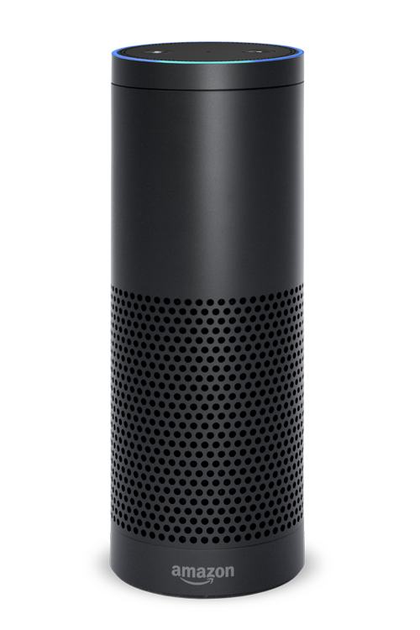
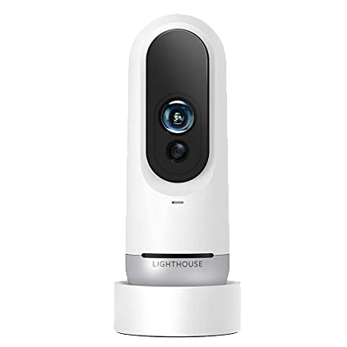
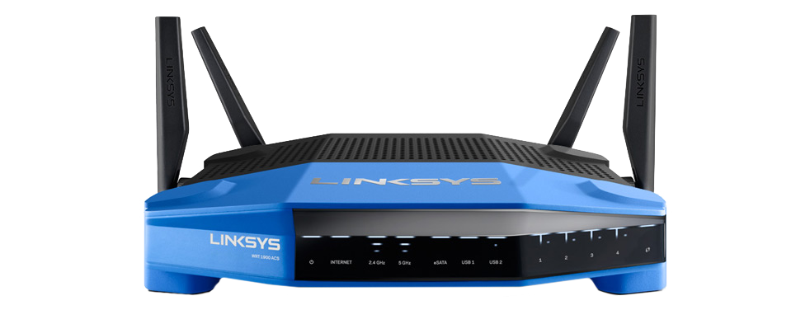

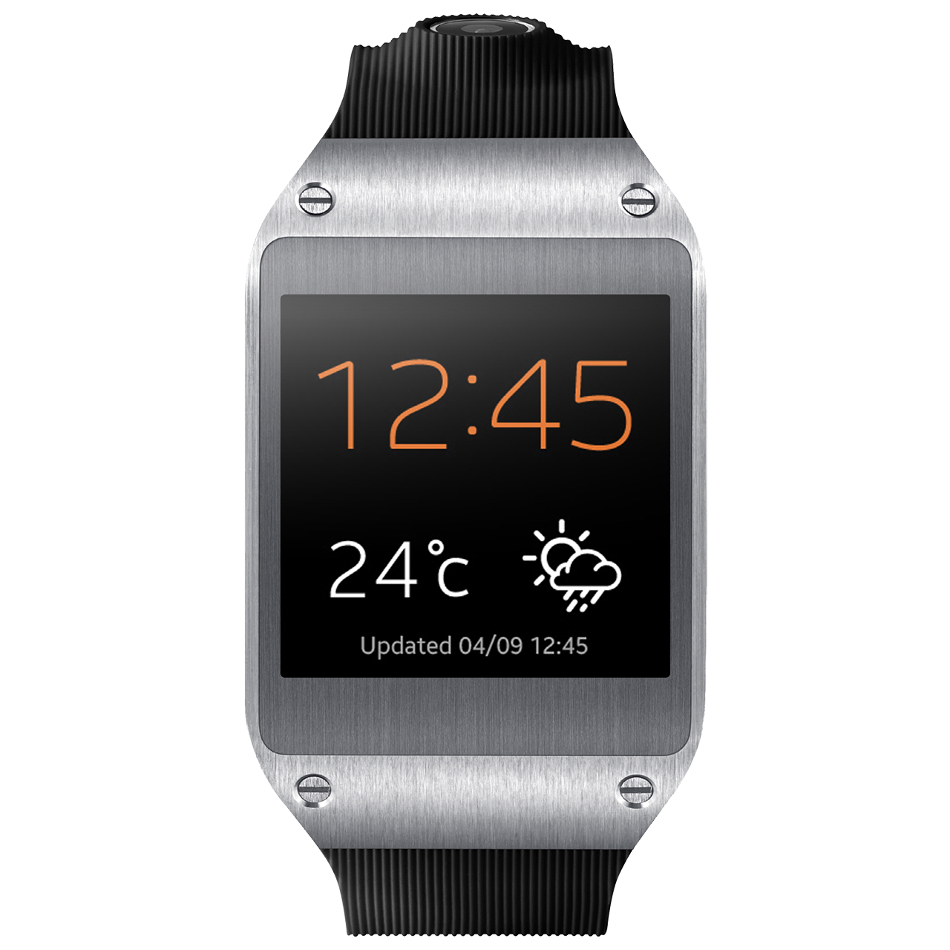

MIPS Open™ Development
TRAINING
TEACHING
EVALUATION
DEVELOPMENT ARCHITECTURE TO CORE
DESIGN+BUILD
CORE TO SOC
CERTIFICATION
SELL
MIPS Open FPGA
Open Source
32-/64-bit ISA
DSP/SIMD VZ/MT
Tools
Software
SDK
Verification Suite
Developed Cores
SOC Design
Students, Universities,
Academics
Core Developer
Developed Cores
Certification Partner
MIPS Open Certified Core
Partner Tools
Software
SDK
Partner Design Services
MIPS Open Certified Core
Customer/
3rd Party IP
Wave
Developers
Partners
SOC
SOC Design
Notes:
This provides summary of the development and certification process.
MIPS Open FPGA – package for teaching, training and evaluation purposes
Develop the cores using MIPS Open Architecture and tools available
Certification Process – Developers do a remote login to the cloud system (that includes verification suite) and verify developed cores to get access to the MIPS Open Certified log
10

Slide 11
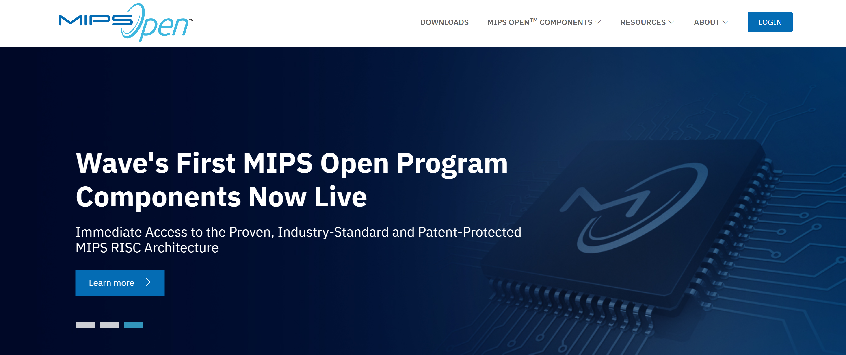
MIPSOpen.com Now Live
Notes:
Please visit mipsopen.com to know more details
11

Slide 12
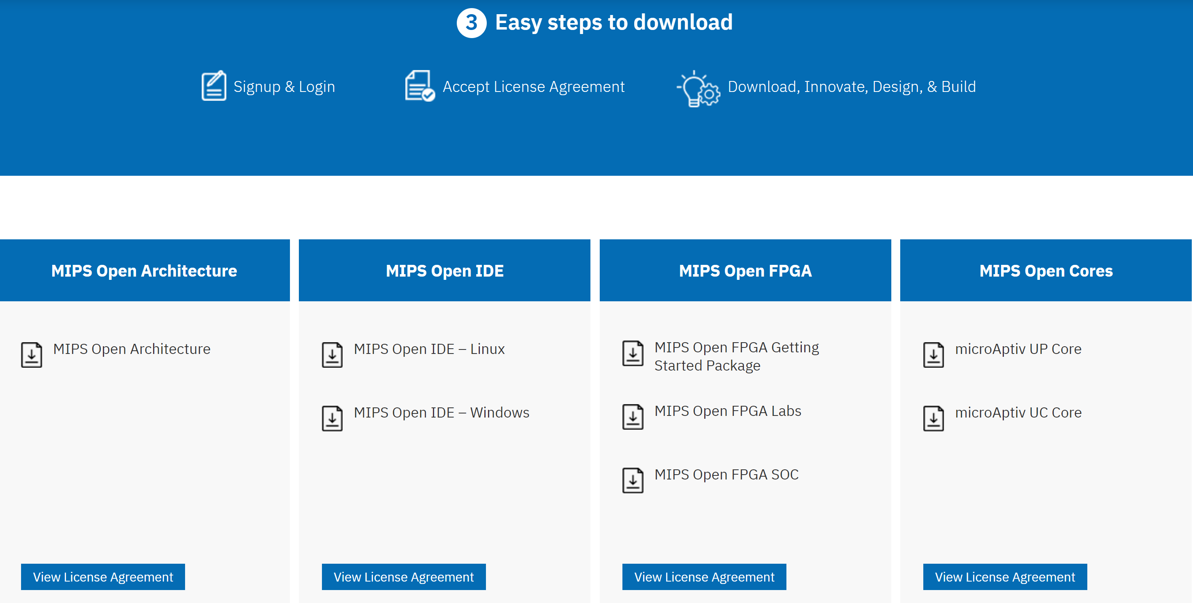
3 Easy Steps to Download, Innovate, Design & Build
Notes:
In 3 easy steps you can download all the packages of architecture, tools, FPGA package or open cores
12

Slide 13
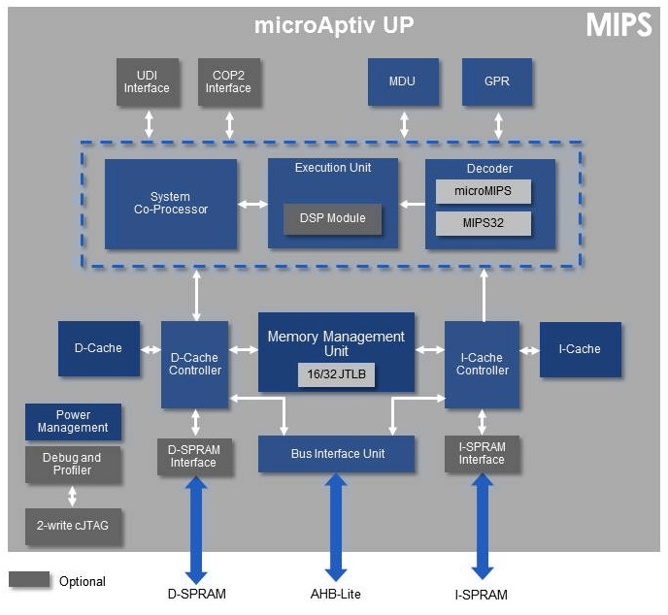
MIPSOpen™ Open Use cores
MIPS Leading in its class Performance efficient microAptiv Cores
Improved 5 stage pipeline architecture
32 GPRs, with up to 16 shadow register sets
Minimal interrupt latency
Integrated DSP ASE outperfroms Cortex-M4
3.5 CoreMarks/MHz, 1.7DMIPs/MHz
Higher performance & scalability
Shadow Registers for faster context switching
Mostly single operation instructions
Simpler memory addressing modes
User Defined Instructions (UDI) for custom ISA
Notes:
In 3 easy steps you can download all the packages of architecture, tools, FPGA package or open cores
13

Slide 14
Demo: MIPS Components in Action
14

Slide 15
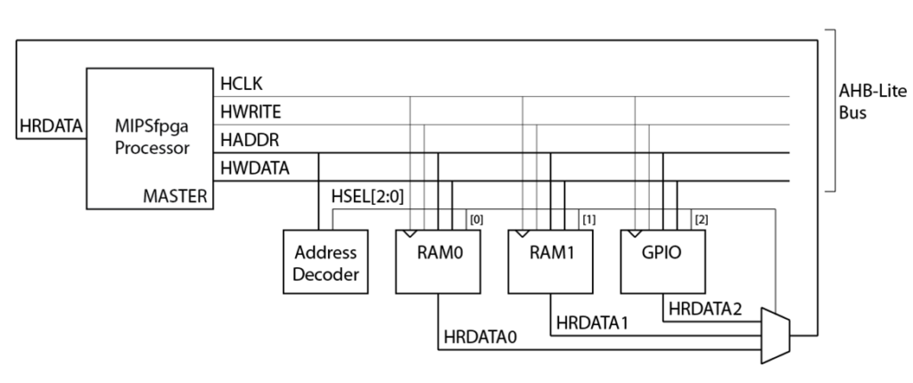
High-level view of MIPS Open FPGA system
15

Slide 16
MIPS microAptiv UP and its interface options
System bus, AHB-Lite, with optional bridge to AXI
CorExtend / UDI - User-Defined Instructions
Cop2 - an older, more flexible and complicated coprocessor interface
Data ScratchPad RAM, DSPRAM
Custom block, can be used as fixed-latency memory or high-speed I/O
Instruction ScratchPad RAM, ISPRAM
16

Slide 17
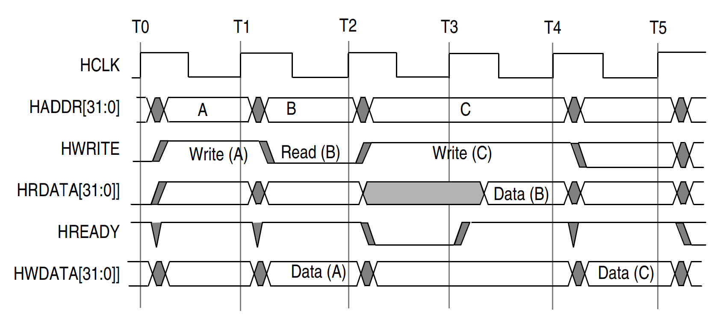
MIPS Open FPGA system bus uses AHB-Lite
17

Slide 18
Other components of MIPS Open FPGA system
Serial loader
A hardware block that receives a file in Motorola S-Record format, parses it using state machine and writes into a system memory
Slow clock for run-time debug
A clock divider that allows running the processors with few Hertz frequency
Useful to observe cycle behavior of the processor in real time
External SDRAM memory controller
External interrupt controller
Extra wiring to support labs to observe cache and CPU pipeline bypasses
18

Slide 19
Take a Break
19

Slide 20
Hands-on Labs & Exercises The workflow
20

Slide 21
Demo & Hands-on Labs
programs/01_light_sensor
programs/02_interrupts
programs/03_cache_misses
programs/04_pipeline_bypasses
21

Slide 22
Housekeeping
For this workshop you will need to connect 3 USB devices (SSD drive, FPGA download cable, USB-to-UART serial cable). We have a 4 port USB hub if you need one.
Connect the drive to USB port
Reboot or start your laptop
Hit key F12 prior to booting your normal OS
Select external USB drive as the new source
You now have Lubuntu loaded with Intel FPGA Quartus and Xilinx Vivado tools
22

Slide 23
Basic usage using command line
cd ~/mipsopen/boards/de10_lite (or another board)
make all load
Press reset (or KEY 0 on some boards) to reset the processor
The default hardcoded program should start to work
cd ~/mipsopen/programs/00_counter (or other program)
make program srecord uart
If computer uses serial connection other than ttyUSB0 (the default), then:
make program srecord uart UART=1 (or 2, 3, etc)
The program uploaded via USB-to-UART is now running
23

Slide 24
Basic usage using synthesis GUI
cd ~/mipsopen /boards/de10_lite (or another board)
For Intel FPGA boards, run ./make_project.sh to create a scratch directory project
Run synthesis and FPGA configuration in scratch directory
Press reset (or KEY 0 on some boards) to reset the processor.
The default hardcoded program should start to work.
cd ~/mipsopen /programs/00_counter (or other program)
make program srecord uart [UART=0,1,2…]
The program uploaded via USB-to-UART is now running.
24

Slide 25
Integration with Light Sensor
programs/01_light_sensor
25

Slide 26
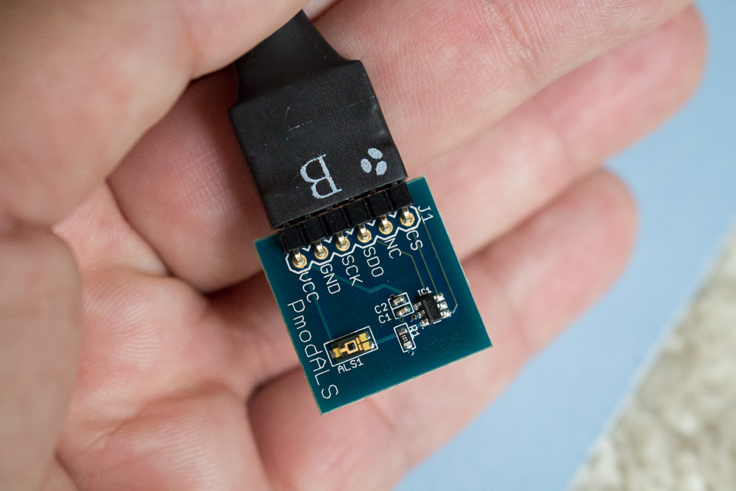
Digilent PmodALS - Ambient Light Sensor
26

Slide 27
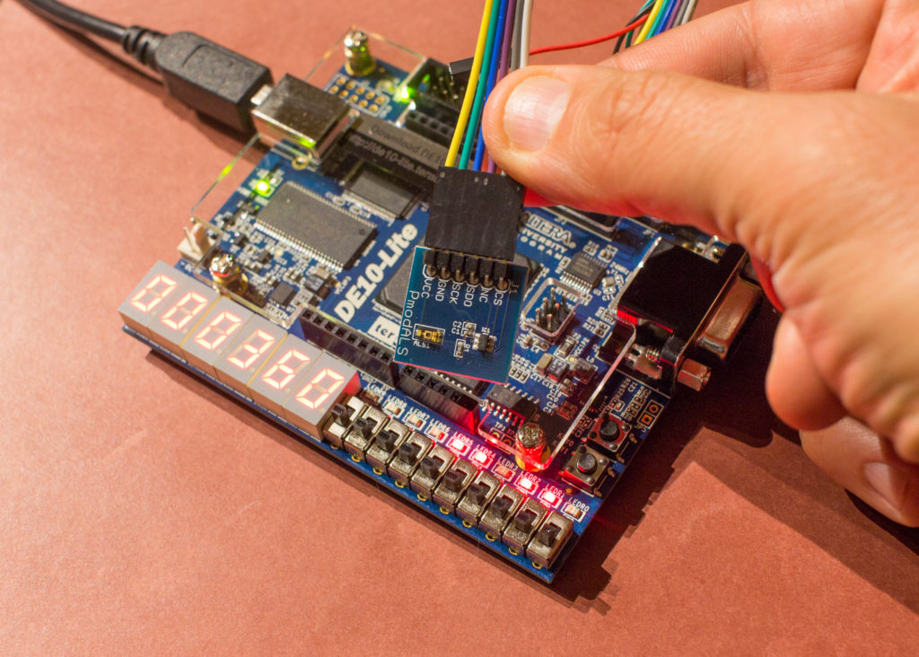
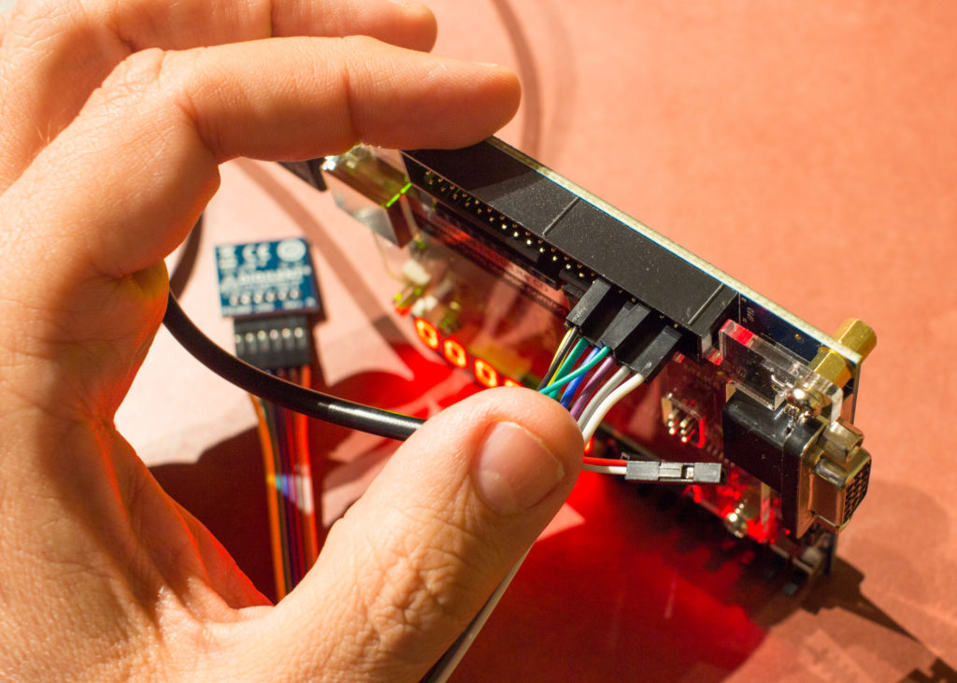
Connecting Light Sensor to Terasic DE10-Lite
USB-to-UART (needed to upload the program into MIPSfpga SoC): green TX jumper goes into 3rd pin from upper right corner, black GND jumper goes into 6th pin from upper right corner. Light Sensor is connected to the second row of pins as shown with color-coded jumpers.
27

Slide 28
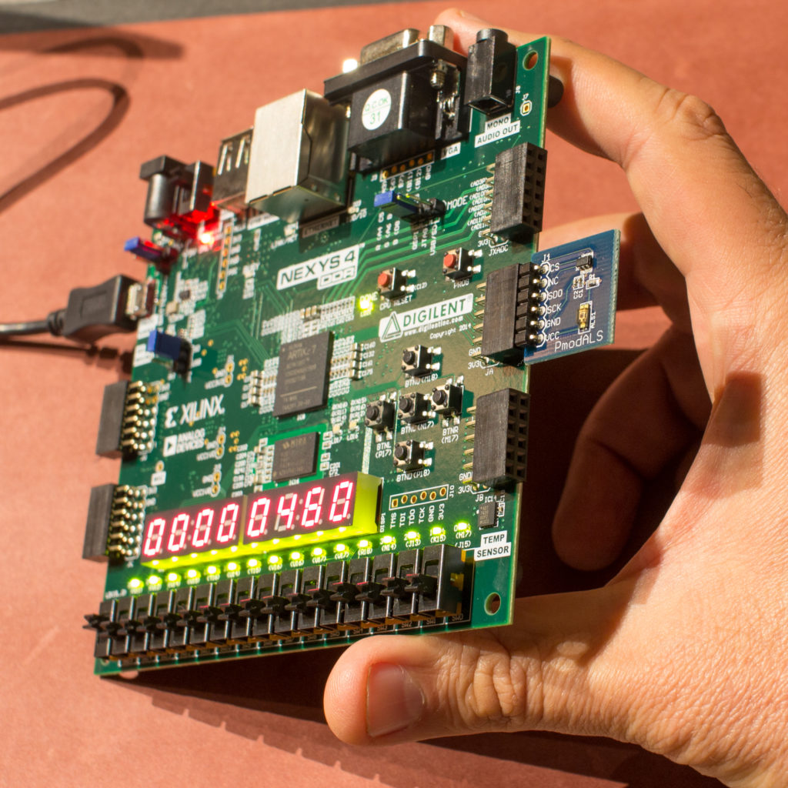
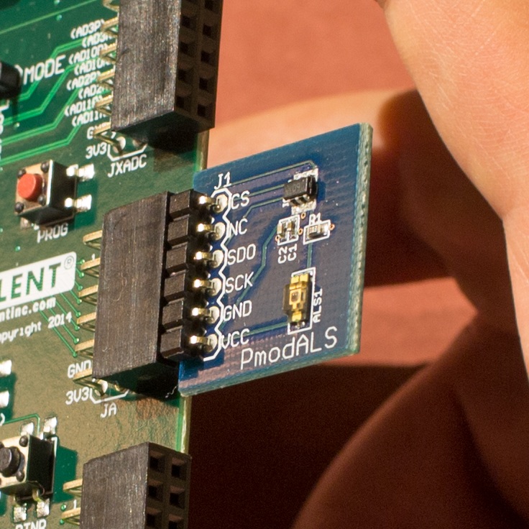
Connecting Light Sensor to Digilent Nexys A7
28

Slide 29
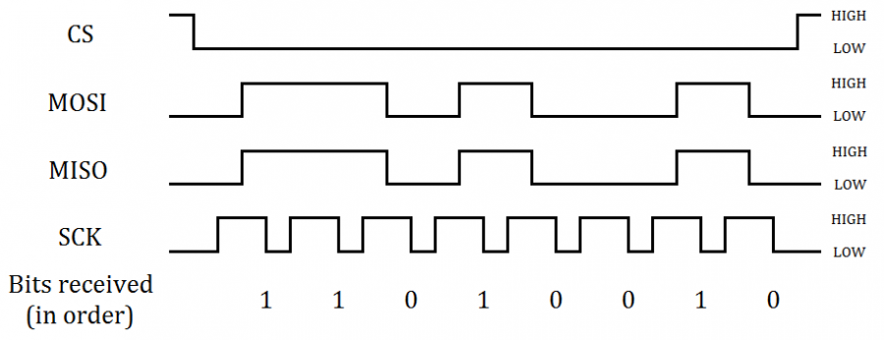
SPI Protocol
https://reference.digilentinc.com/pmod:communication_protocols:spi
29

Slide 30
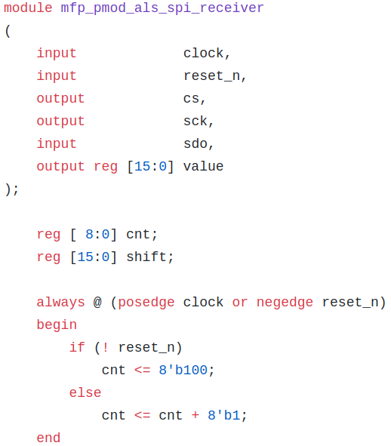
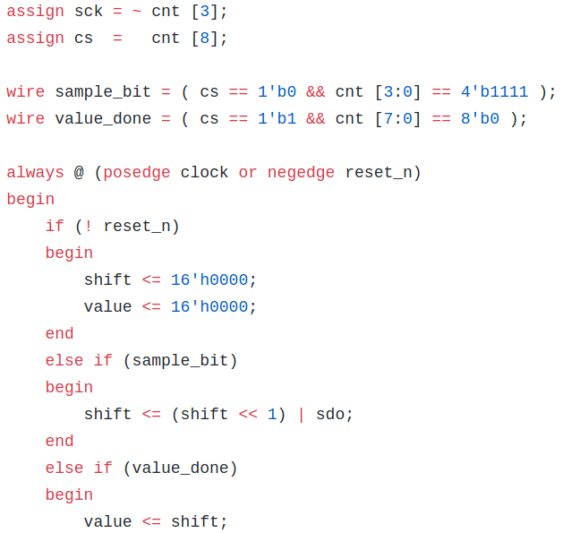
Light Sensor SPI interface module
system_rtl/mfp_pmod_als_spi_receiver.v
30

Slide 31
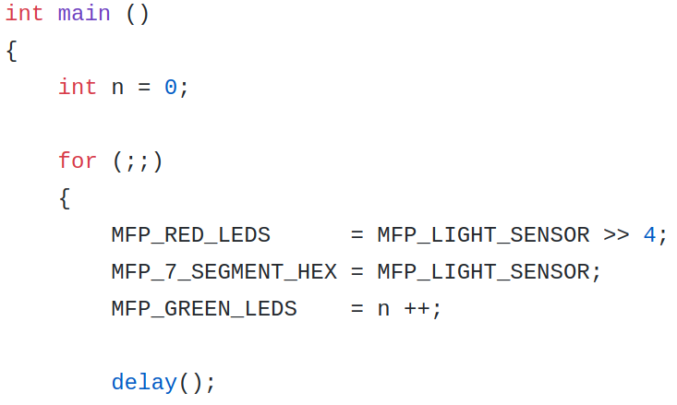
Program that does memory-mapped I/O
programs/01_light_sensor/main.c
31

Slide 32
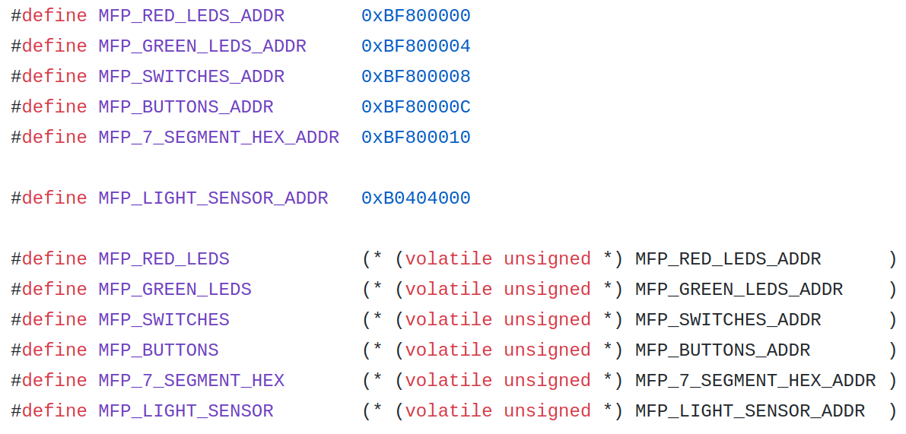
Header that defines uncached I/O addresses
programs/01_light_sensor/mfp_memory_mapped_registers.h
32

Slide 33
To integrate software and hardware together
programs/01_light_sensor/main.c
programs/01_light_sensor/mfp_memory_mapped_registers.h
system_rtl/mfp_pmod_als_spi_receiver.v
system_rtl/mfp_ahb_lite_pmod_als.v
system_rtl/mfp_ahb_lite_matrix_config.vh
system_rtl/mfp_ahb_lite_matrix.v
system_rtl/mfp_ahb_lite_matrix_with_loader.v
system_rtl/mfp_system.v
boards/de10_lite/de10_lite.v
boards/nexys4_ddr/nexys4_ddr.v
33

Slide 34
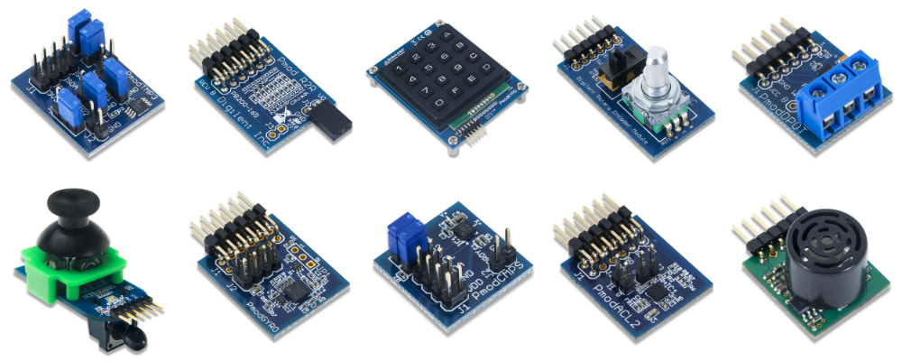
Other sensors from Digilent
Keyboard
Rotary encoder
Ultrasonic distance sensor
34

Slide 35
Interrupts
programs/02_interrupts
35

Slide 36
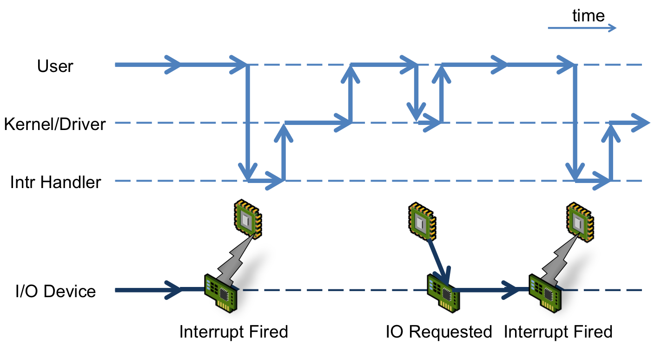
The action of an I/O interrupt
Interrupts in the exercise are driven by pressing buttons on the board
The source of the figure: http://virtualirfan.com/history-of-interrupts
36

Slide 37
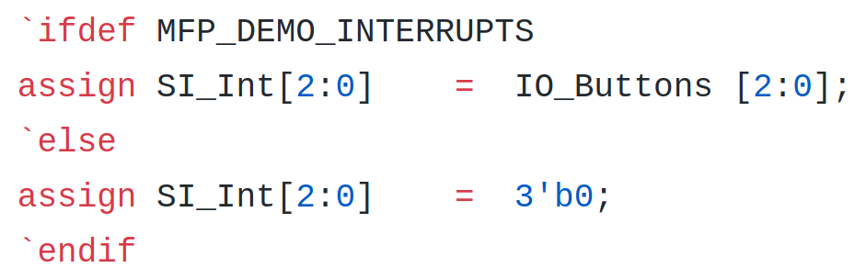
Modifications in hardware
Connecting buttons to interrupt signals inside system_rtl/mfp_system.v
37

Slide 38
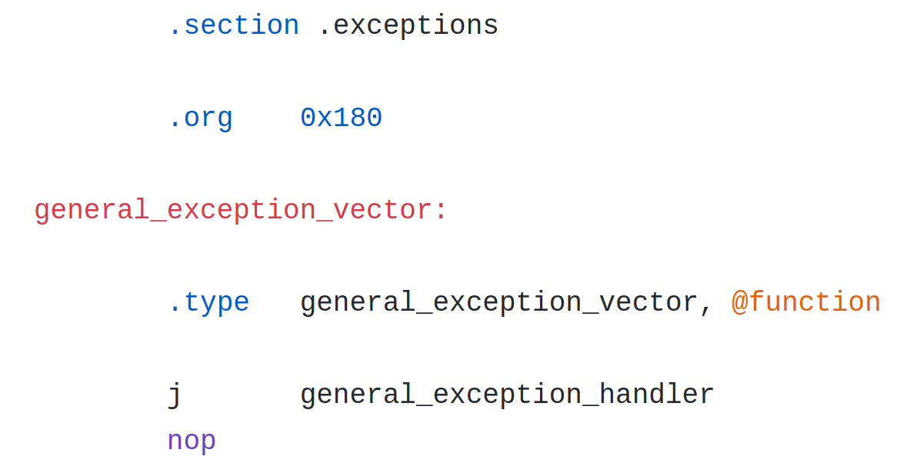
Software side
Default general exception handler in programs/02_interrupts/exceptions.S
38

Slide 39
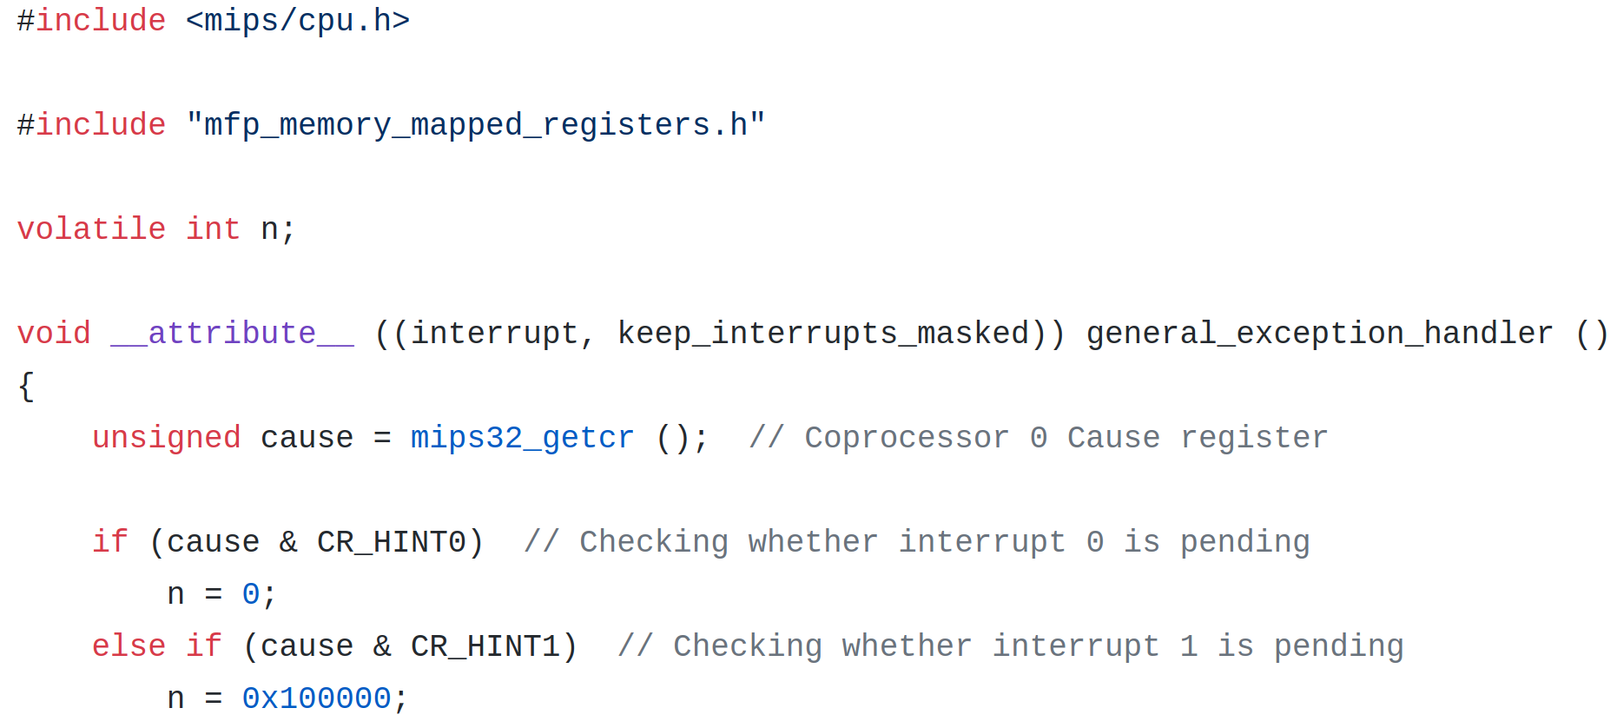
Software side
Custom general exception handler in programs/02_interrupts/main.c
39

Slide 40
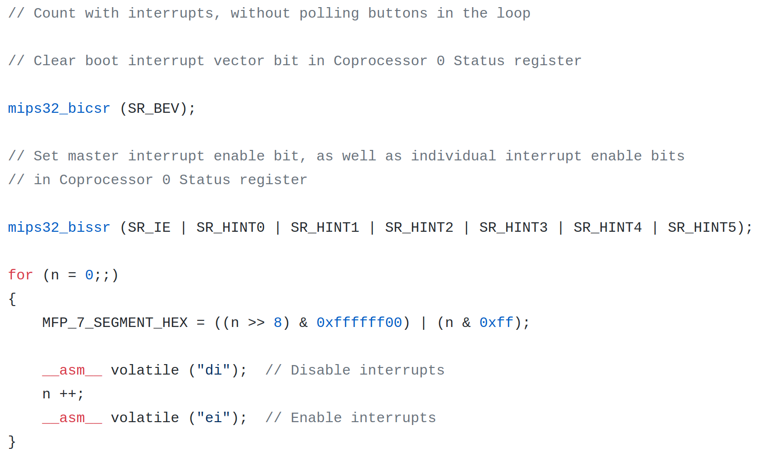
Software side
Setting the interrupts in programs/02_interrupts/main.c
40

Slide 41
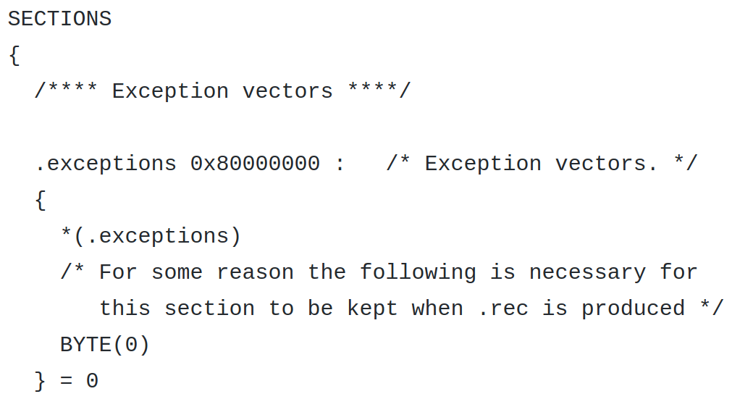
Software side
Changes in linker script in programs/02_interrupts/program.ld
41

Slide 42
Observing CPU L1 cache in action
programs/03_cache_misses
42

Slide 43
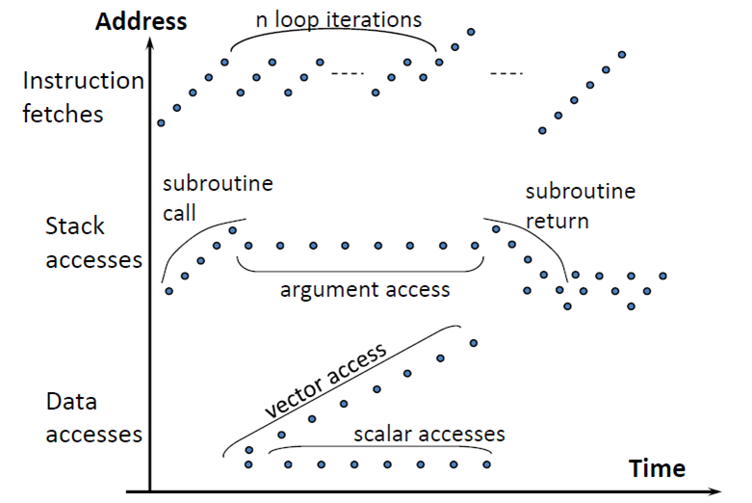
Causing different patterns of cache misses
Caches exploit temporal and spatial locality of instructions and data to improve the processor’s performance
MIPS microAptiv UP core has several cache configurations:
I-cache and D-cache
1, 2, 3 or 4 way set associative
1, 2, 4, 8, 16 KB
MIPS Open Day Package allows to directly observe cache behavior on LED with slow clock feature
Memory access patterns from Computer Architecture course by David Wentzlaff from Princeton University. 2011.
43

Slide 44
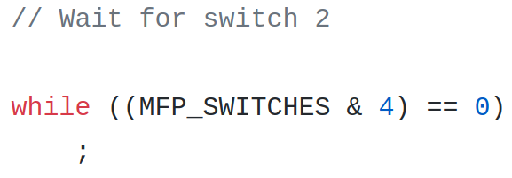
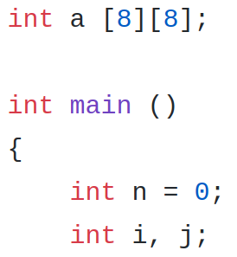
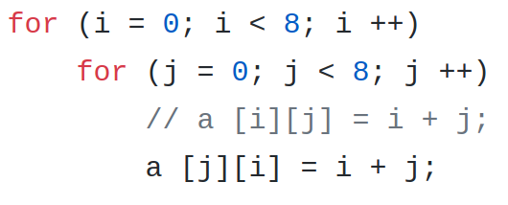
Program with different cache miss patterns
programs/02_cache_misses/main.c
44

Slide 45
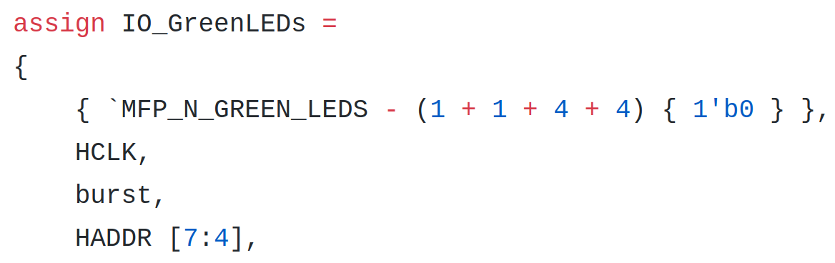
Modifications in hardware
Connecting cache miss signals to LED inside system_rtl/mfp_system.v
45

Slide 46
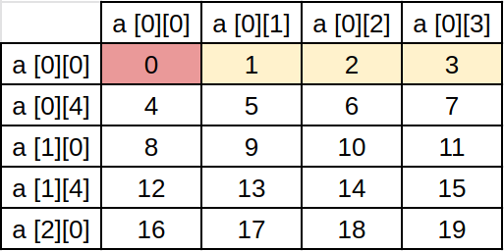
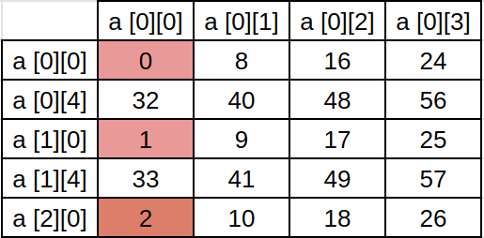
Different patterns of cache misses in time
Pattern data:
Miss/Blink, Hit/Nothing, Nothing, Nothing
Miss/Blink, Hit/Nothing, Nothing, Nothing
. . . . . .
Pattern for data:
Series of 8 misses, then 24 hits
Series of 8 misses, then 24 hits again
Watch for misses because of instructions
46

Slide 47
Exposing CPU Pipeline Bypasses
programs/04_pipeline_bypasses
47

Slide 48
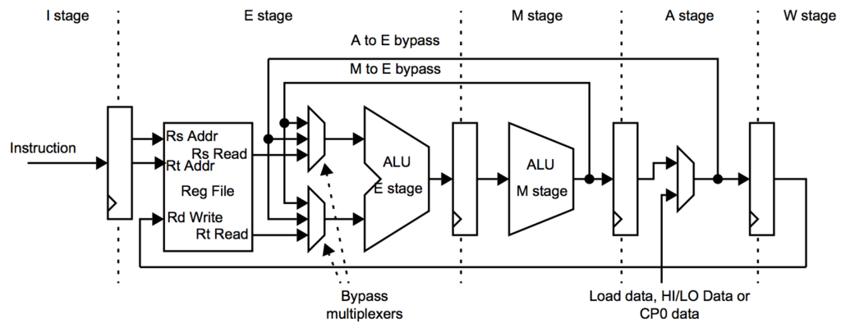
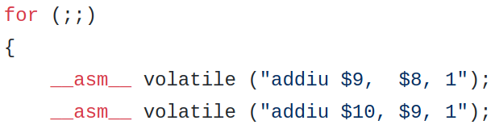
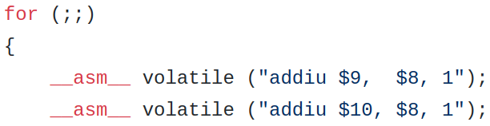
Pipeline bypasses and code that exposes them
48

Slide 49
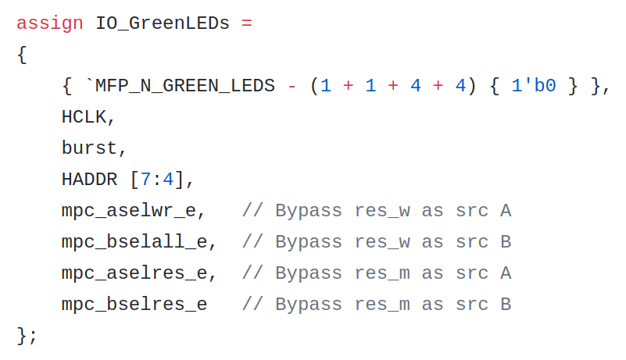
Modifications in hardware
Connecting pipeline bypass signals to LEDs inside system_rtl/mfp_system.v
49

Slide 50
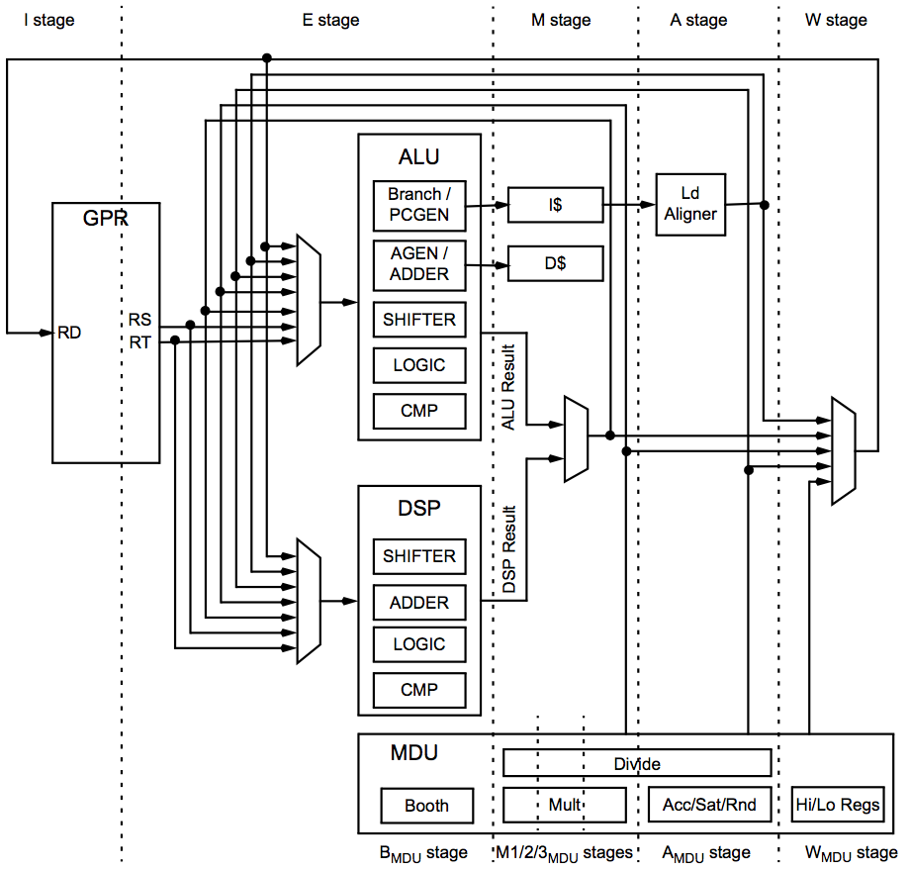
More pipelining to explore in microAptiv UP core
GPR – general purpose registers
DSP – extension for accelerating Digital Signal Processing algorithms
Such as digital filters, FFT
Uses light vector operations
Options for saturation and rounding
MDU – Multiply / Divide Unit
Different area/performance options
Configurable in MIPS Open core
Fixed in MIPSfpga
Note: DSP and MDU options are available in full MIPS microAptiv UP core, not in basic configuration of MIPSfpga. User can configure full core and replace core source in MIPSfpga.
50

Slide 51
Take a Break
51

Slide 52
Build Your own SoC
Present Your Innovation
52

Slide 53
Build Your own SoC
Present Your Innovation
https://www.mipsopen.com/forums/forum/mips-open-developer-day-june-4th-2019/
53

Slide 54
https://www.mipsopen.com/forums/forum/mips-open-developer-day-june-4th-2019/
54

Slide 55
Extending CPU with CorExtend interface UDI – User Defined Instructions
55

Slide 56
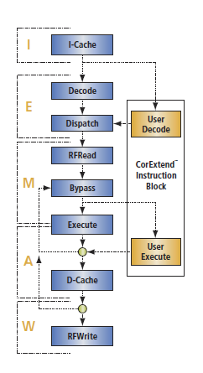
An interface option: CorExtend
Another name for UDI, User-Defined Instructions.
Easy to use mechanism for adding new instructions
User implements a custom block in Verilog.
Instructions read from two general-purpose registers and write back into a specified register.
The added instructions do not have to stall the pipe.
The added instructions can stall the pipe if necessary.
There is a mechanism to kill the instructions in event of a processor exception.
The block can have internal state and connect to outside logic.
56

Slide 57
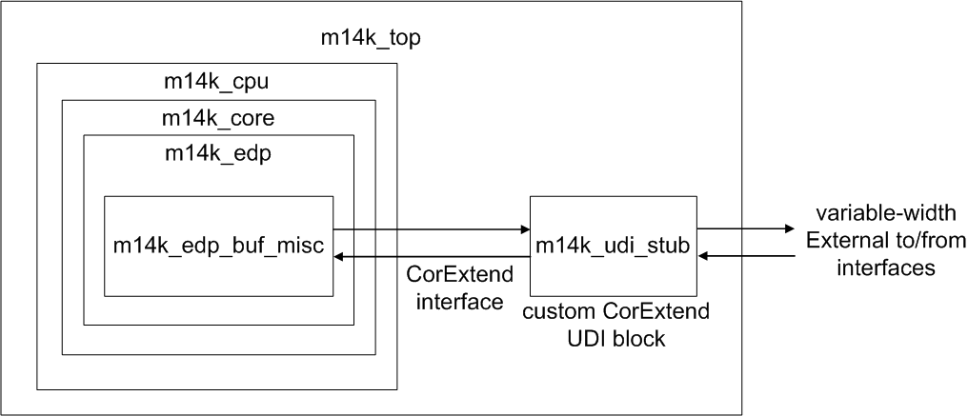
CorExtend block inside the core
http://zatslogic.blogspot.com/2016/01/using-mips-microaptiv-up-processor.html
57

Slide 58
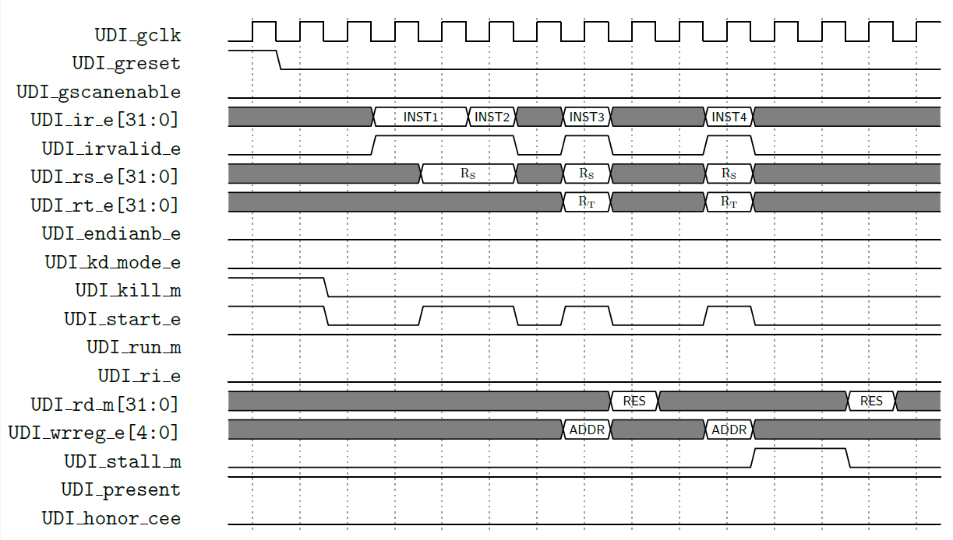
CorExtend instruction processing
http://zatslogic.blogspot.com/2016/01/using-mips-microaptiv-up-processor.html
58

Slide 59
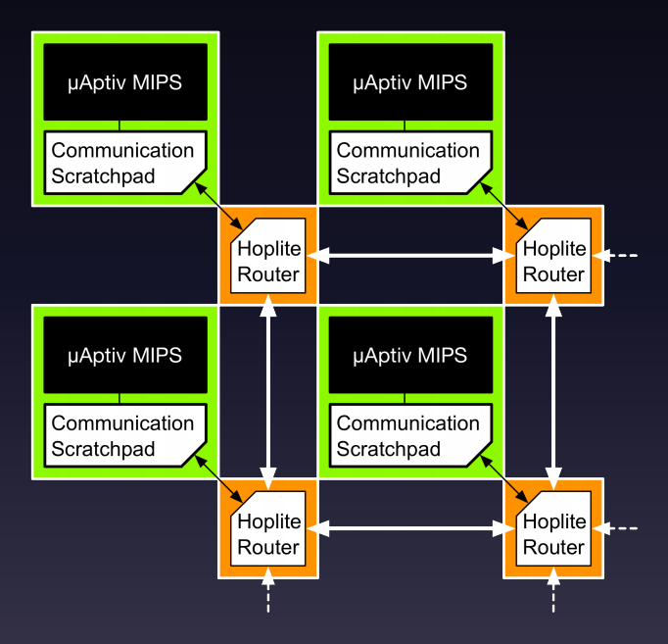
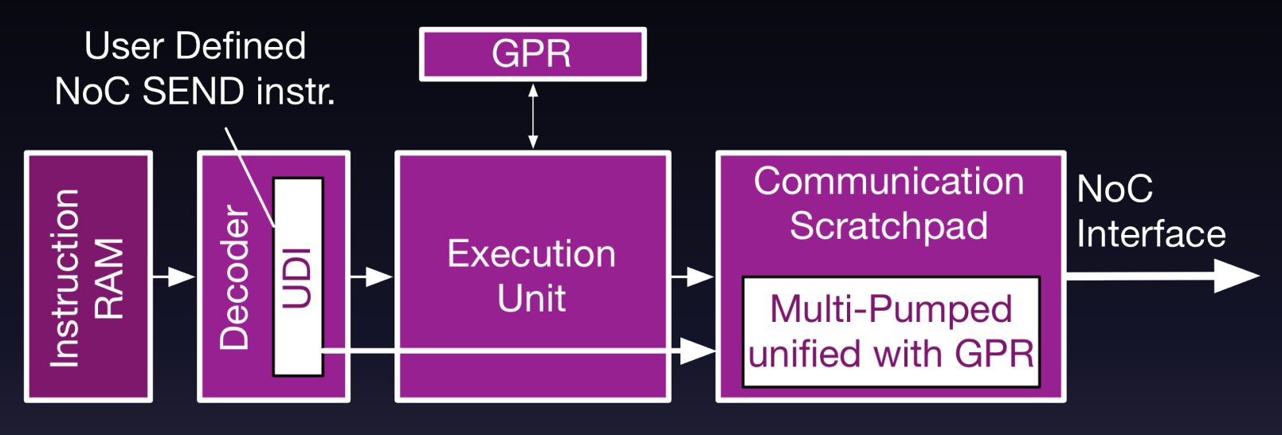
An example of UDI use for multiprocessing
120 cores working on Terasic DE5-Net board with Altera / Intel FPGA
The instructions to send messages between the processors in non-coherent mesh
http://www.isfpga.org/fpga2017/slides/D2_S3_04.pdf and http://nachiket.github.io/publications/mips_fpga2017.pdf
59

Slide 60
A proof of concept using CorExtend for AI
60

Slide 61
A proof of concept using CorExtend for AI
Analyze an AI algorithm
Define a formula to compute in hardware
D0 * W0 + D1 * W1 + D2 * W2 + D3 * W3
Define the format of CorExtend instructions to accelerate the computation
Implement a custom CorExtend block
Create a set of C macros for the programming convenience
Create two implementations of the algorithm
Pure software
Mixed software-hardware
Analyze the generated assembly code
Run the comparison benchmark
61

Slide 62
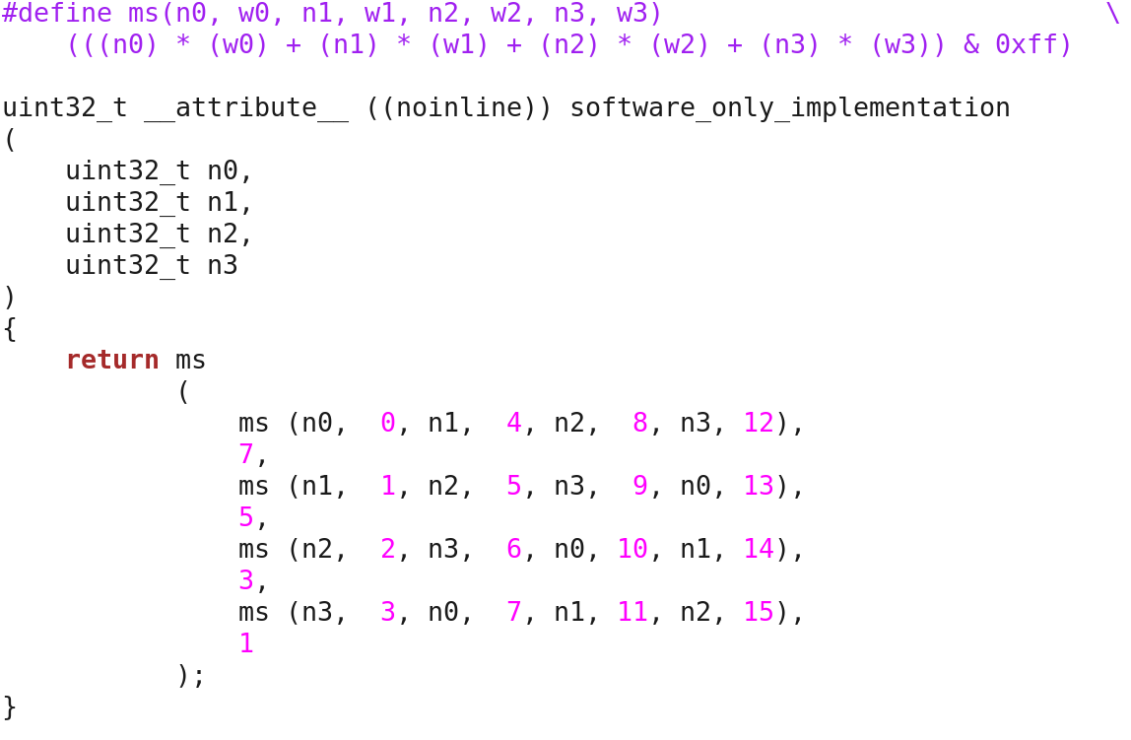
A test example: the algorithm in software
62

Slide 63
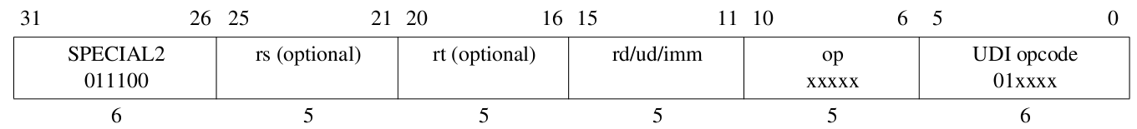
Three formats of UDI instructions
Three formats of UDI instructions
UDIop_{[3:0]} rs, rt, rd, imm5_{10:6}
UDIop_{[3:0]} rs, rt, imm10_{15:6}
UDIop_{[3:0]} rs, imm15_{20:6}
UDI5 $7, $3, $15, 30
UDI0 t0, t1, 665
UDI15 a0, a1, v0, 0x7133
You can make up to 19 bit immediate by reducing the number of UDI instructions
63

Slide 64
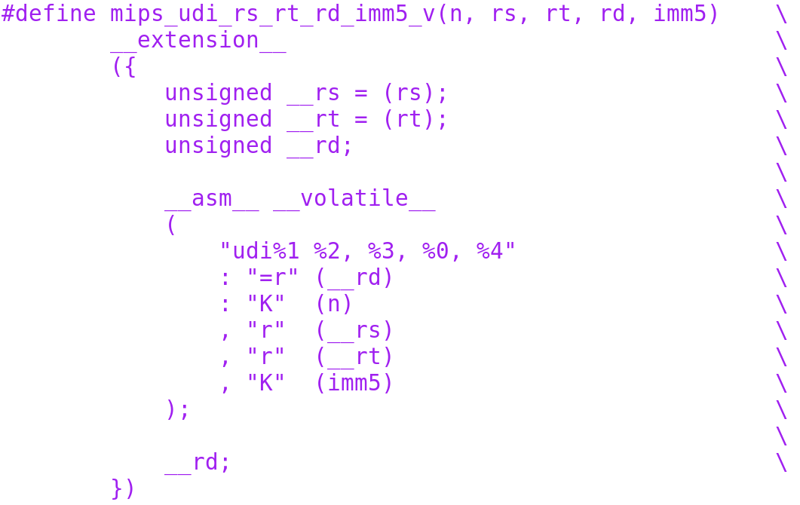
C macro for UDI using GCC __asm__ extension
Wave Computing © 2019
64

Slide 65
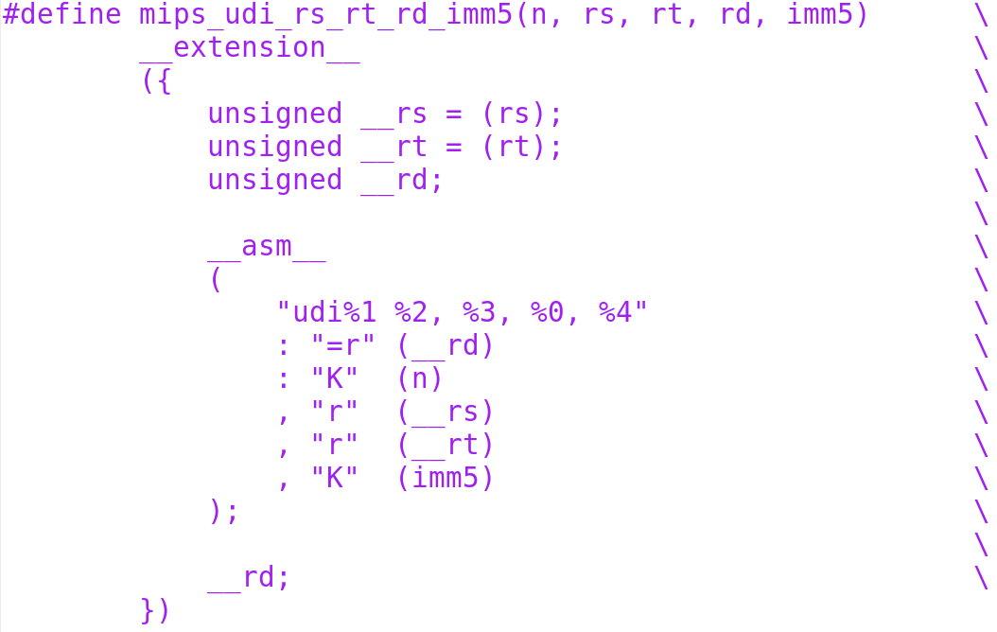
Version without __volatile__ to use additional GCC optimizations
65

Slide 66
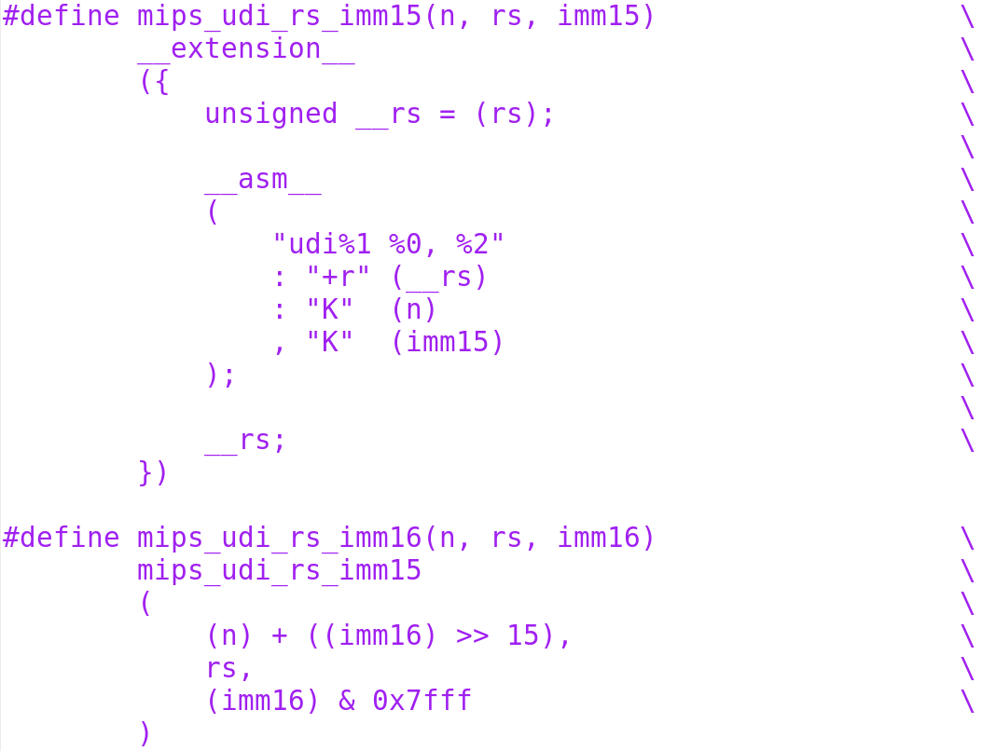
Three formats of UDI instructions
A format with one register
16-bit immediate
The register is both source and destination
Number of UDI instructions is reduced to 8
But we have extra bit for immediate
66

Slide 67

Algorithm-specific macro
uses generic UDI macro
67

Slide 68

The code in mixed software-hardware
is the same
Wave Computing © 2019
68

Slide 69

The generated assembly
47 instructions without UDI
25 instructions with UDI
69

Slide 70

The software test - uses FPGA board peripherals
70

Slide 71

CorExtend block code - 1
71

Slide 72

CorExtend block code - 2
72

Slide 73

CorExtend block code - 3
73

Slide 74

CorExtend block code - 4
74

Slide 75

CorExtend block code - 5
75

Slide 76

Simulate MIPS Open system
using Verilog simulator
76

Slide 77
The results of the simulation
The computation results matches
Software computation takes 62 cycles
Software-hardware computation takes 30 cycles - two times less
The result can be improved orders of magnitude by making complicated AI engine that has both CorExtend and DSPRAM interfaces for highly parallel multi-functional computational unit
77

Slide 78

Synthesis – the whole MIPS Open FPGA system
78

Slide 79

UDI submodule
79

Slide 80
Synthesis for the system
Fits 65% of Terasic DE10-Lite board
80

Slide 81

Fmax 33 MHz is practical even for Linux debug
81

Slide 82
Housekeeping
Return Hardware
Altera/Xilinx FPGA Boards
USB Hub
Cables
Housekeeping
Please delete the Altera Quartus and Xilinx Vivado tools on the SSD!!!
When you leave the class, please leave the FPGA boards, cables and USB hub.
The SSD is yours to take home
82

Slide 83
Thank You

